Slide 1
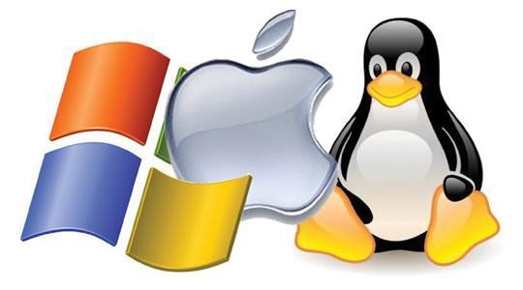
CS-3103 : Operating Systems : Sec-A (NB) : Operating-System Structures

Slide 2
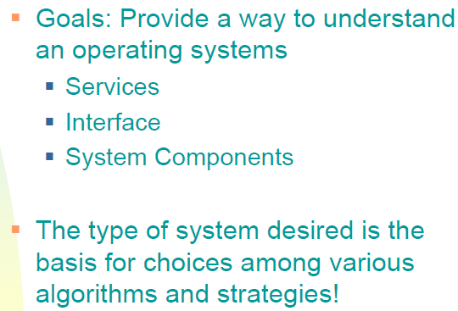

Slide 3
OS Services Helpful to the User
User interface - Almost all operating systems have a user interface (UI). This interface can take several forms:
  Command-Line (CLI) -- uses text commands and a method for entering them (say, a keyboard for typing in commands in a specific format with specific options).
  Graphics User Interface (GUI) -- the interface is a window system with a pointing device to direct I\O, choose from menus, and make selections and a keyboard to enter text..
  Batch Interface -- commands and directives to control those commands are entered into files, and those files are executed
  Some systems provide two or all three of these variations.
Program execution - The system must be able to load a program into memory and to run that program, end execution, either normally or abnormally (indicating error)
I/O operations - A running program may require I/O, which may involve a file or an I/O device

Slide 4

A View of Operating System Services

Slide 5
Command Interpreters (CLI)
CLI allows users to directly enter commands to be performed by the operating system.
Some operating systems include the command interpreter in the kernel.
Some operating systems, such as Windows and UNIX, treat the command interpreter as a special program that is running when a job is initiated or when a user first logs on.
On systems with multiple command interpreters to choose from, the interpreters are known as shells.
The main function of the command interpreter is to get and execute the next user-specified command.
Sometimes commands built-in, sometimes just names of programs
  If the latter, adding new features doesn’t require shell modification

Slide 6
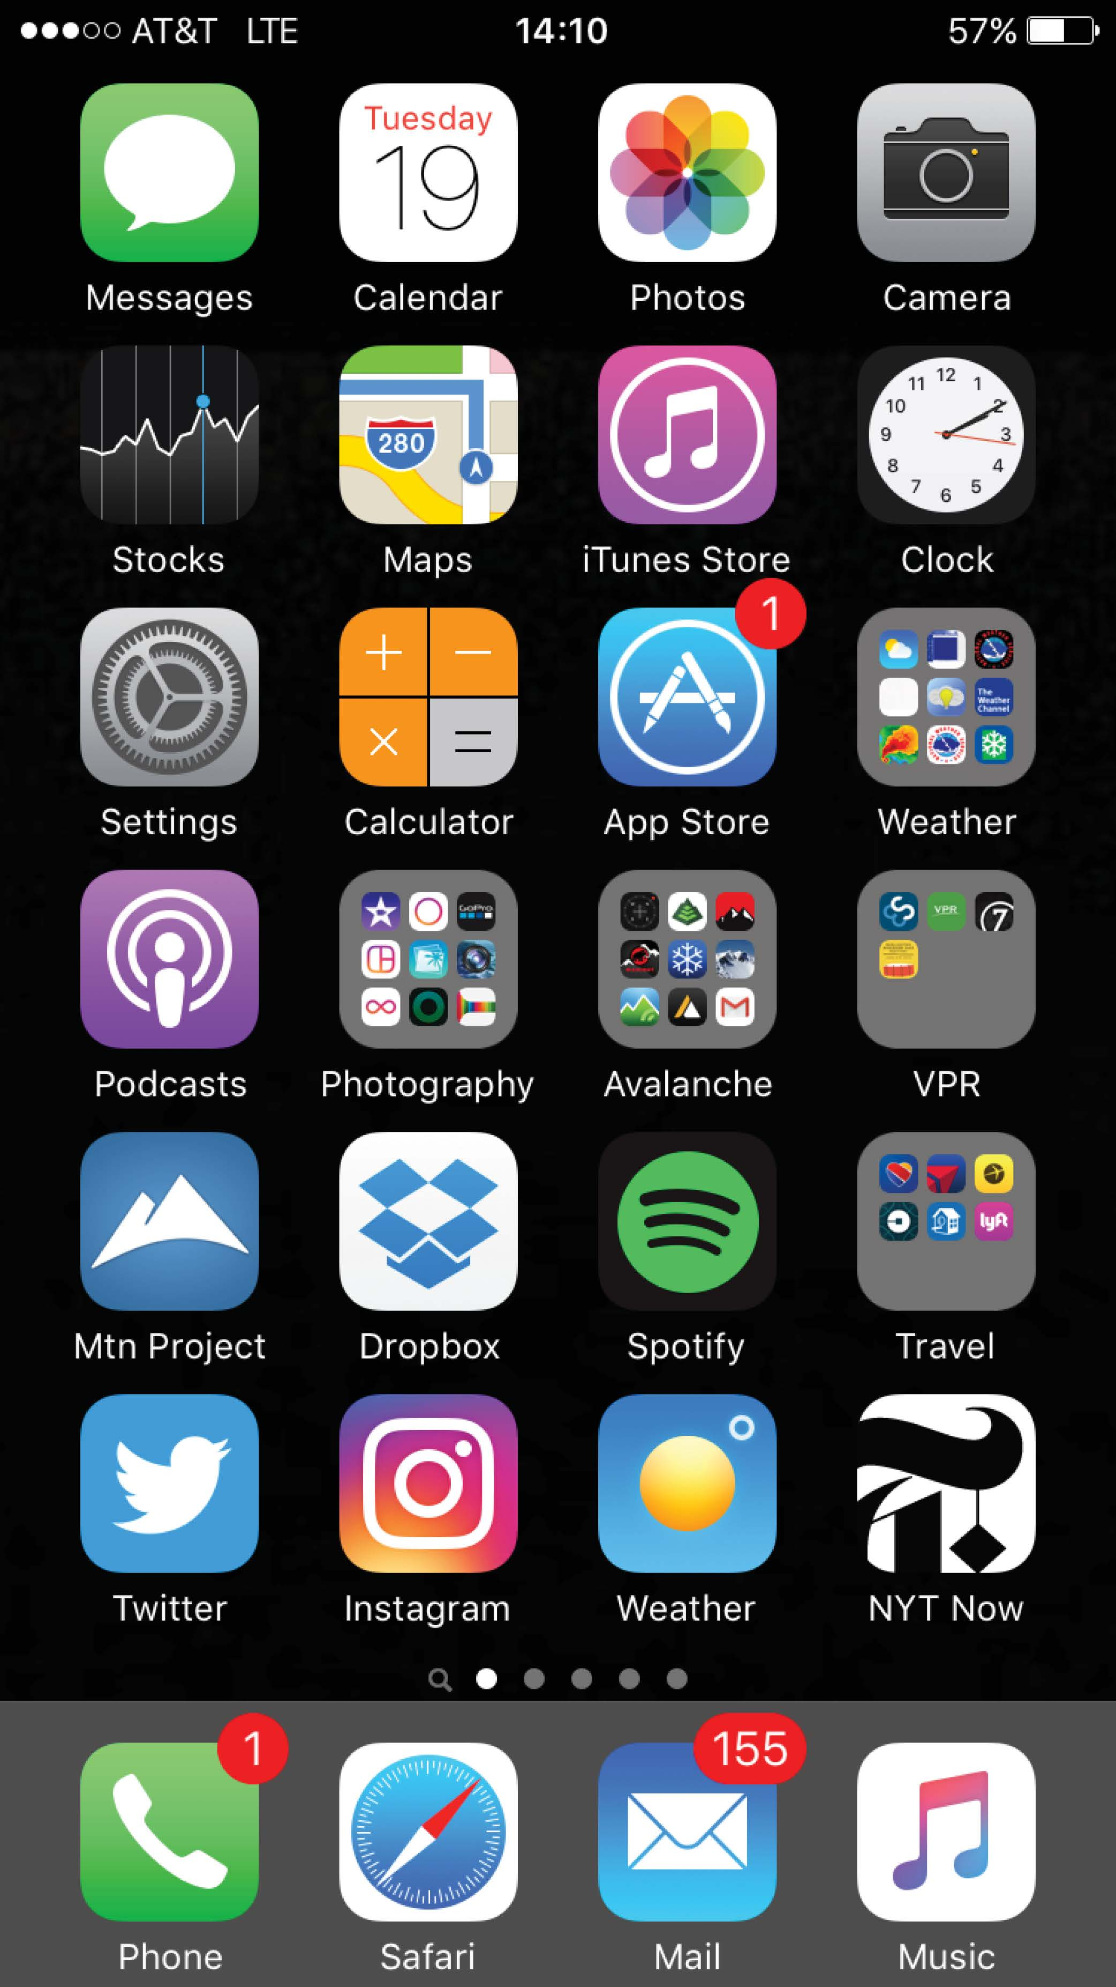
Touchscreen Interfaces
Touchscreen devices require new interfaces
  Mouse not possible or not desired
  Actions and selection based on gestures
  Virtual keyboard for text entry
Voice commands.

Slide 7
System Calls
Programming interface to the services provided by the OS
Typically written in a high-level language (C or C++)
Mostly accessed by programs via a high-level Application Programming Interface (API) rather than direct system call
Three most common APIs are:
  Win32 API for Windows,
  POSIX API for POSIX-based systems (including virtually all versions of UNIX, Linux, and Mac OS X),
  Java API for the Java virtual machine (JVM)

Slide 8

Examples of Windows and Unix System Calls

Slide 9
Android
Developed by Open Handset Alliance (mostly Google)
  Open Source
Similar stack to iOS
Based on Linux kernel but modified
  Provides process, memory, device-driver management
  Adds power management
Runtime environment includes core set of libraries and Dalvik virtual machine
  Apps developed in Java plus Android API
    Java class files compiled to Java bytecode then translated to executable than runs in Dalvik VM
Libraries include frameworks for web browser (webkit), database (SQLite), multimedia, smaller libc

Slide 10
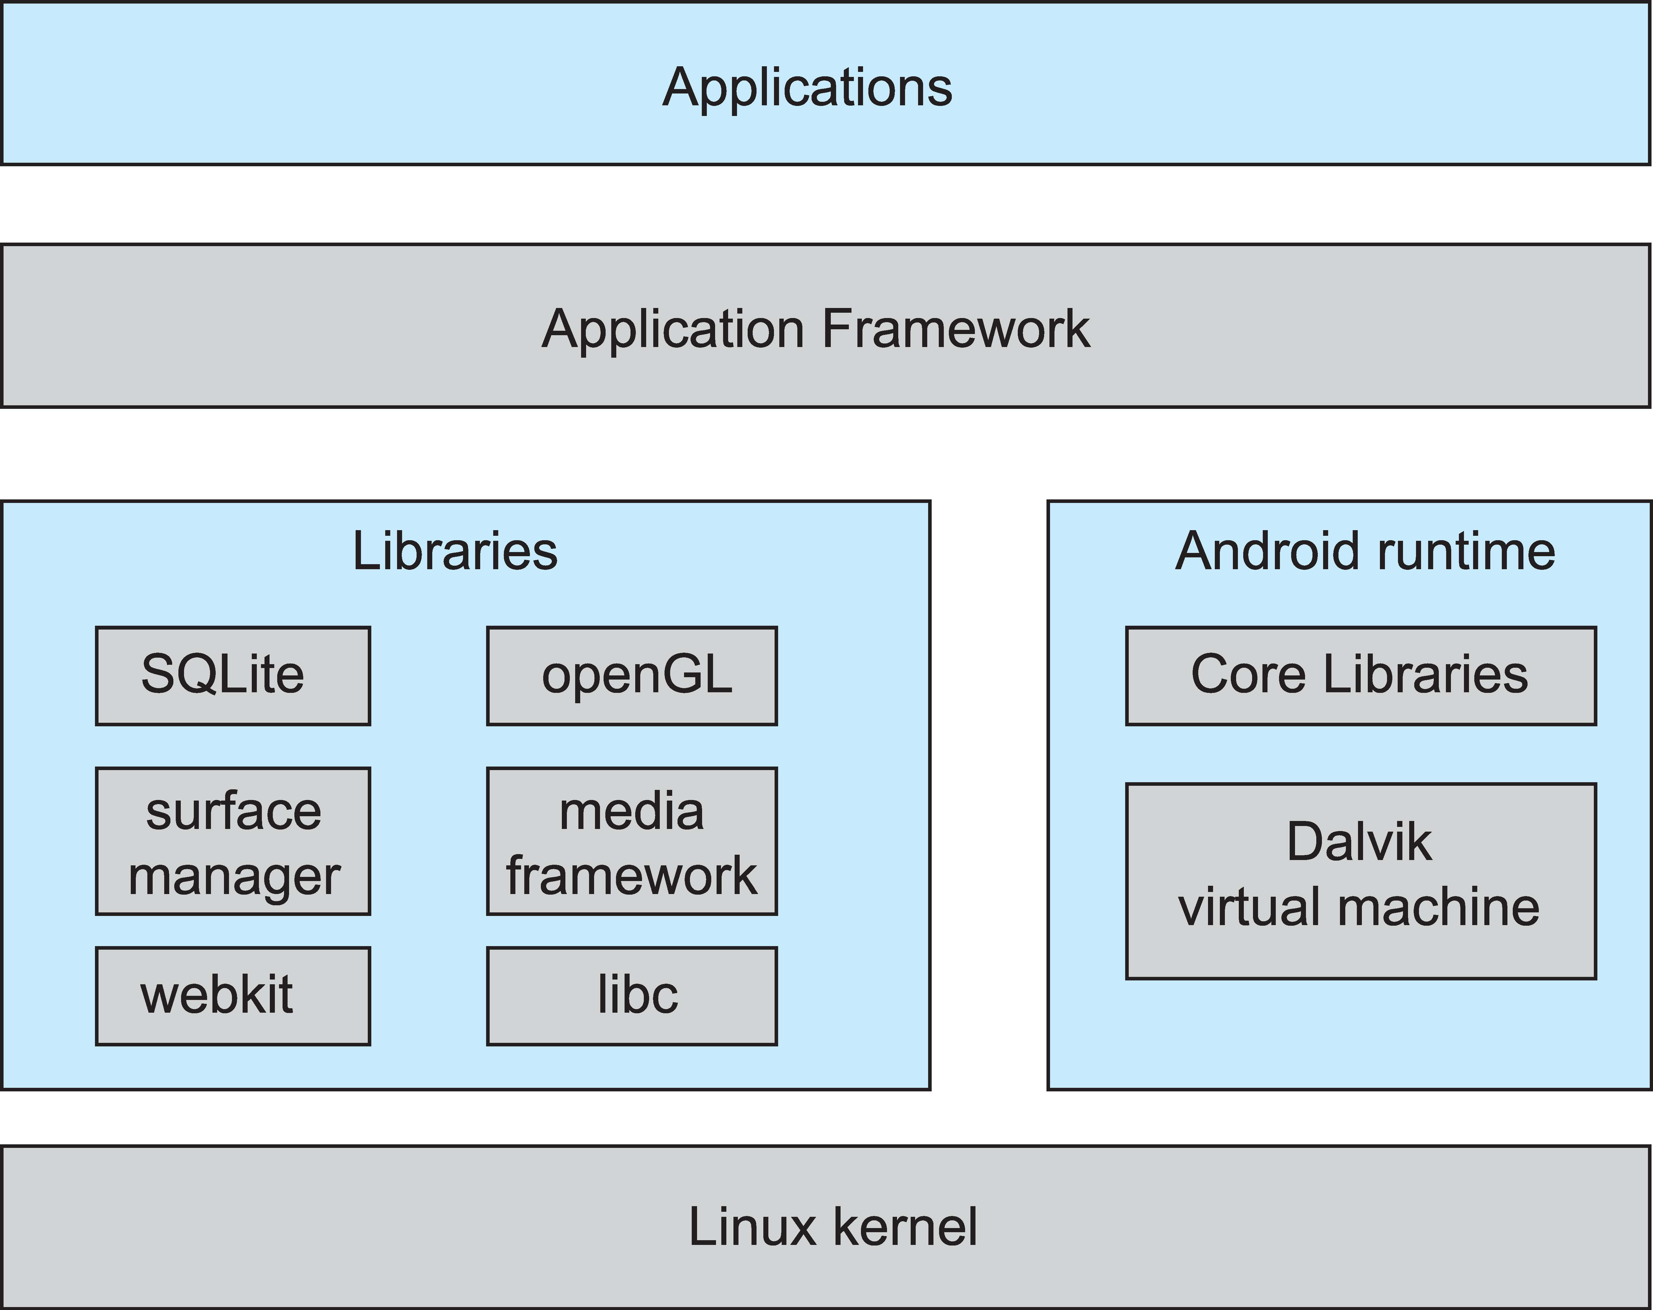
Android Architecture

Slide 11
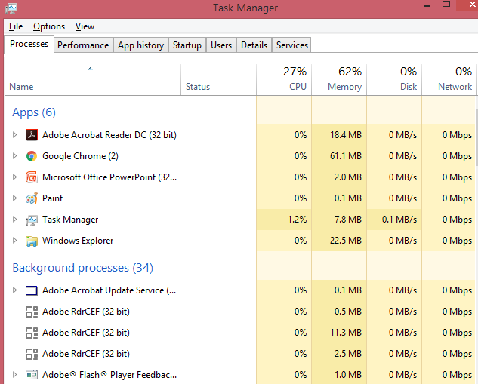
Performance Tuning: Example, “top” program or Windows Task Manager

Slide 12
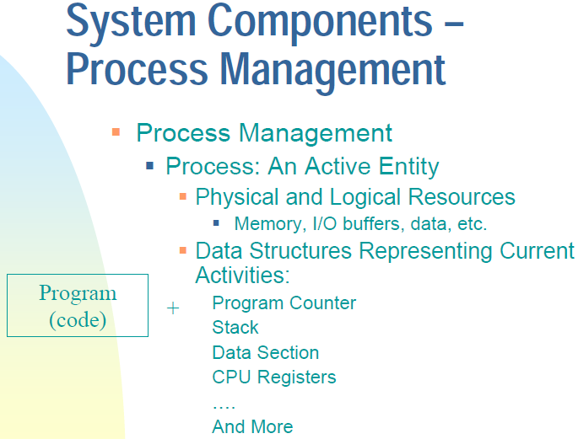

Slide 13
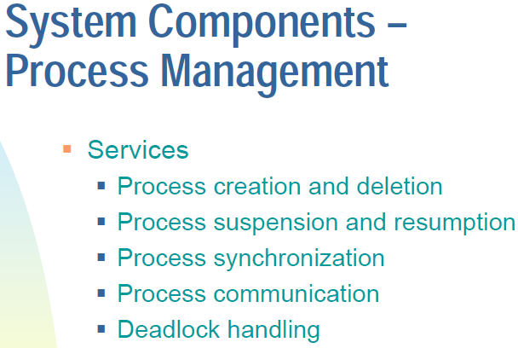

Slide 14
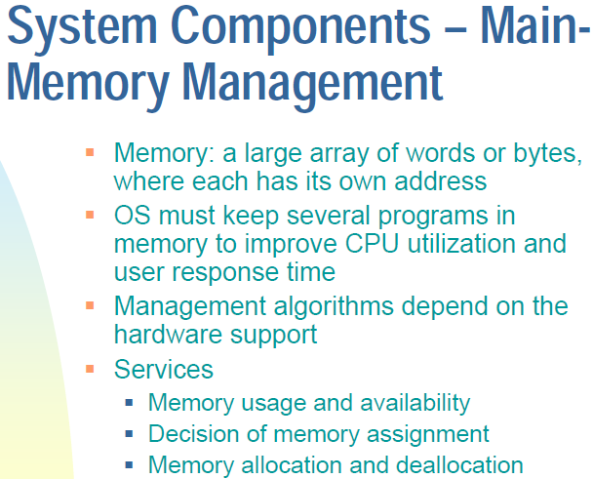

Slide 15
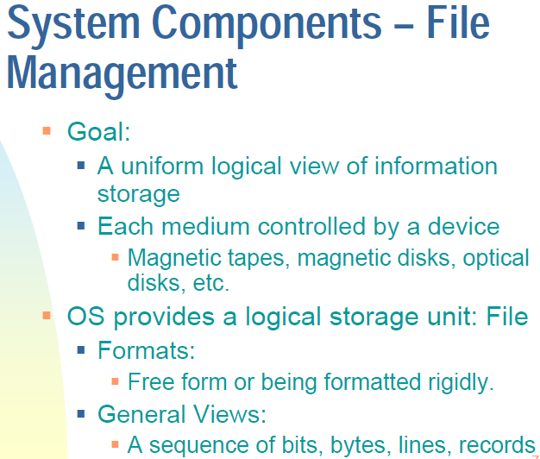

Slide 16
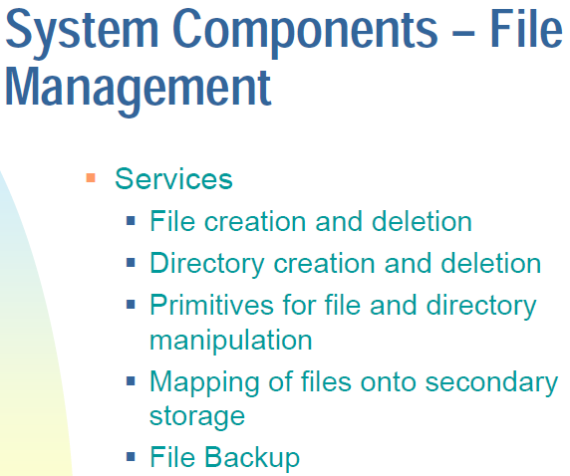

Slide 17
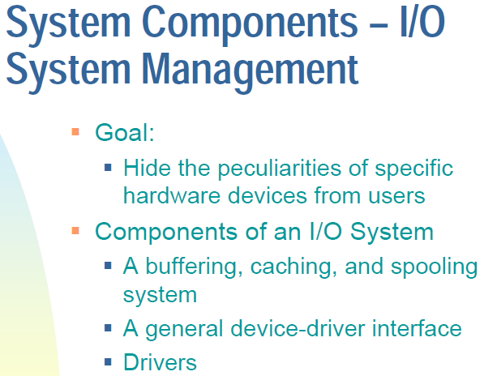

Slide 18
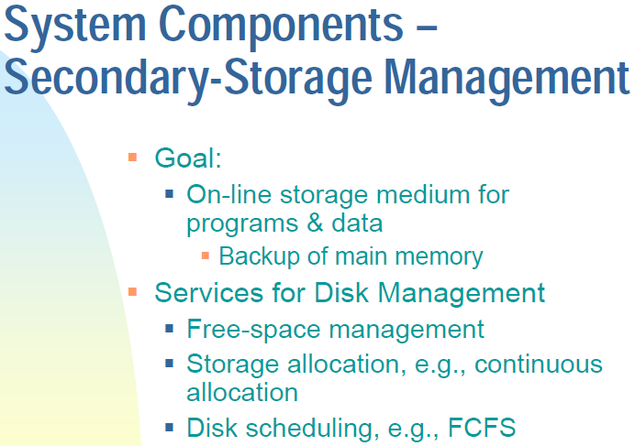

Slide 19
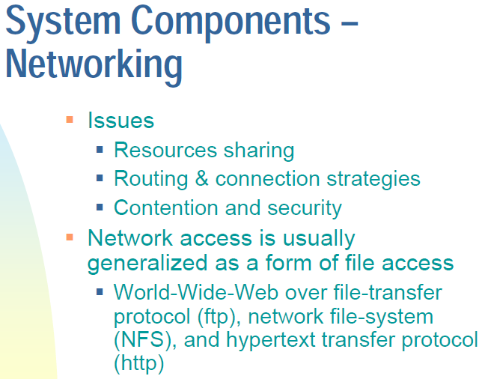

Slide 20
